Slide 1
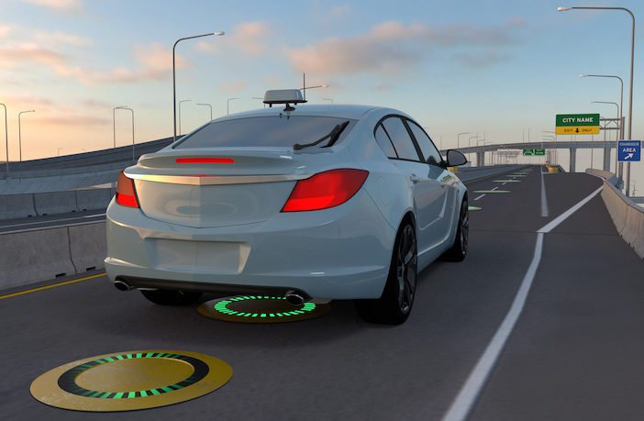
WIRELESS BYPASS Charging System For E-Vehicle using DARRIEUS
TEAM
Naresh kumar M P
Sanjay kumar S
Arul S
Final year – ECE .
MENTOR
Mrs V. Jino shiny . ME
Assistant professor , ECE.
Stella Mary’s College of Engineering.
.

Slide 2
OBJECTIVE
Wireless bypass charging in electric vehicles (EVs) aims to enhance user convenience and charging flexibility. The primary objective is to enable EVs to charge wirelessly while on the move, without the need to plug in.
This technology allows vehicles to recharge their batteries automatically while driving over designated wireless charging pads embedded in the road.
Seamless charging experience.
Extended driving range.
Increased energy efficiency.
Enhanced safety and reliability.

Slide 3
INTRODUCTION
Electric vehicles (E-vehicles) are gaining prominence as a sustainable transportation solution.-
One of the critical challenges in E-vehicle adoption is the availability of reliable charging infrastructure.
The wireless bypass charging system powered by wind turbines offers an innovative solution.
This system combines renewable energy from wind turbines with wireless charging technology.-
It aims to make E-vehicle charging more accessible and eco-friendly in diverse locations.

Slide 4
LITERATURE SURVEY
Sno. | Year of Publication | Author | Method | Advantage | Disadvantage
1 | 2019 | M.S.Ahmed, K. R. Smith | Bypass charging with battery storage for wireless EV charging | Efficient utilization of wind energy. | Implementation Complexity
2 | 2020 | J. H. Kim, S. H. Park, L. G. Lee | Direct EV charging without intermediary batteries | Reduced system cost and complexity. | Inconsistent charging rates in low wind conditions.
3 | 2019 | X. Chen, Y. Liu, Z. Wang | Wind turbine integrated with resonant inductive coupling for charging. | High efficiency charging. | Complex electromagnetic design.

Slide 5
Sno | Year of Publication | Author | Method | Advantage | Disadvantage
4 | 2019 | R. Zhang, L. Li, H. Wang | Bypass charging method with resonant inductive coupling. | Maximizes wind energy utilization. | Complex implementation requiring sophisticated electronics.
5 | 2021 | R. K. Sharma, S. K. Jain, R. S. Singh | Hybrid bypass charging with super capacitors | Continuous charging in varying weather. | Initial high investment
6 | 2021 | S. M. Patel, A. Gupta, M. Singh | Bypass charging using wind turbine and energy storage | Enhanced energy management. | Increased initial setup cost.

Slide 6
Sno | Year of Publication | Author | Method | Advantage | Disadvantage
7 | 2019 | T. Wang, X. Zhang | Bypass charging with resonant inductive coupling | Efficient power transfer to EVs. | Complex implementation.
8 | 2020 | A. N. Parks, M. S. Ahmed | Bypass charging with battery storage. | Maximized wind energy utilization. | Implementation complexity.
9 | 2022 | A. Gupta, S. M. Patel, M. Singh | Hybrid energy storage with wind turbine for bypass charging. | Enhanced energy reliability | Increased system complexity.

Slide 7
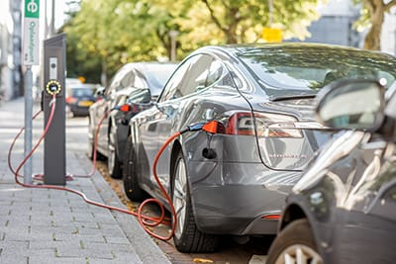
PLUG IN CHARGING METHOD
EXISTING SYSTEMS
Level - 1 charging : 120 volts AC -22KW
Level -2 charging : 240 volts AC

Slide 8
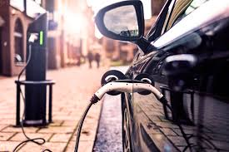
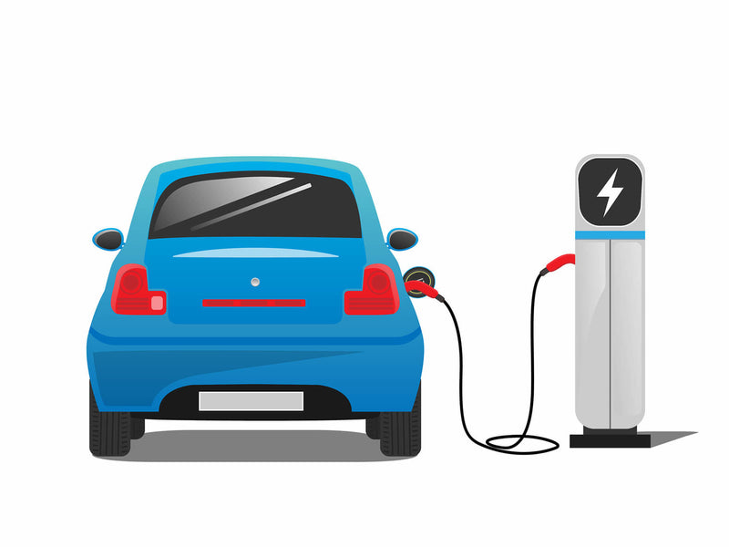
DIRECT CURRENT FAST CHARGING METHOD (DCFC)
Rapid charging – 55Kw.
Duration of complete charging 30 minutes to 1 hour.
Installed in Highways.

Slide 9
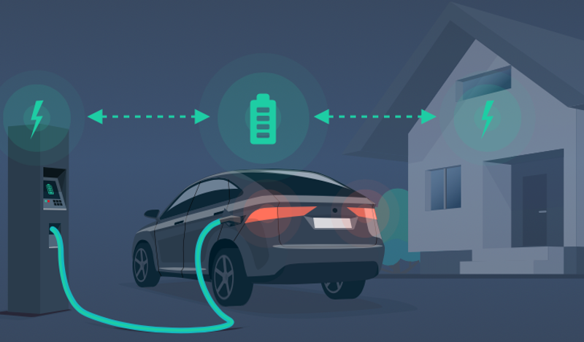
VEHICLE-TO-GRID (V2G) CHARGING
Vehicle-to-grid technology allows EVs to not only receive energy from the grid but also to send excess energy stored in their batteries back to the grid when needed.

Slide 10
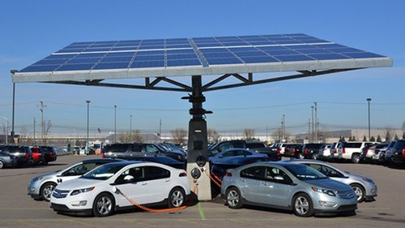
ON-SITE SOLAR PANNEL CHARGING
Energy directly consumed from panels of solar.
Charge the vehicle through charging port.
These mechanism has efficiently time consuming.

Slide 11
PROPOSED SYSTEM
BLOCK DIAGRAM
Using DARRIEUS wind generate electricity
Using transformer step down the AC current
Transmitter coil
installed in the charging pad road setup.
Through the coil, battery gets charged on the motion.
Using Rectifier AC energy is converted to DC.
Receiver coil is installed inside the vehicles.

Slide 12
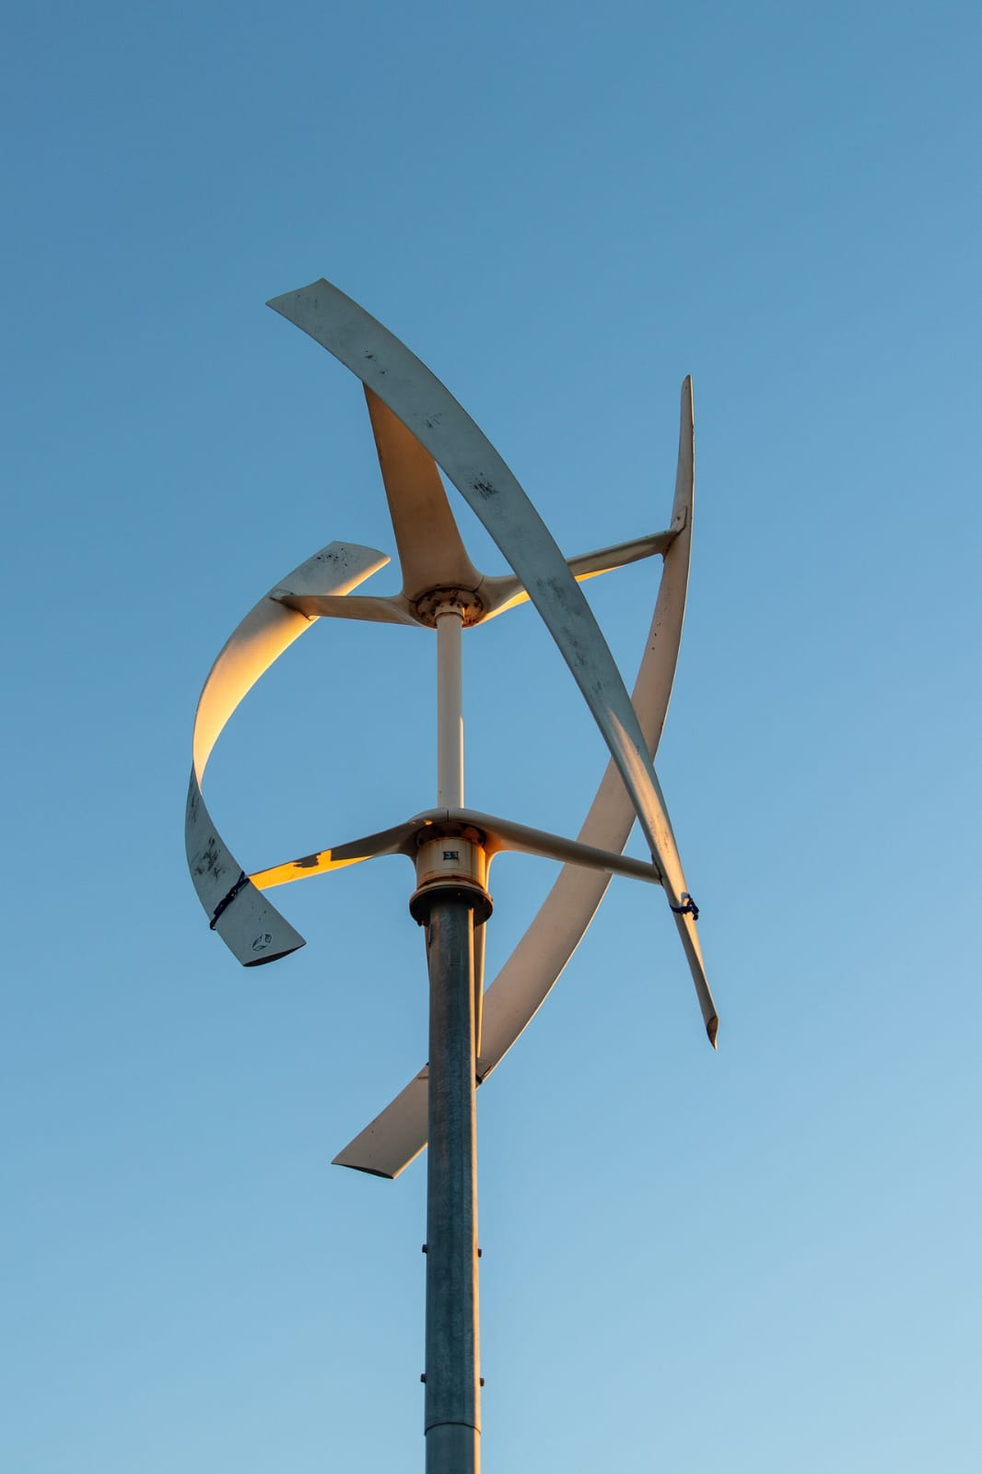
1. Darrieus wind turbine is a Vertical Axis Wind Turbine (VAWT). 2. It has a curved aerofoil blades mounted on the rotating shaft.
DARRIEUS WIND TURBINE

Slide 13
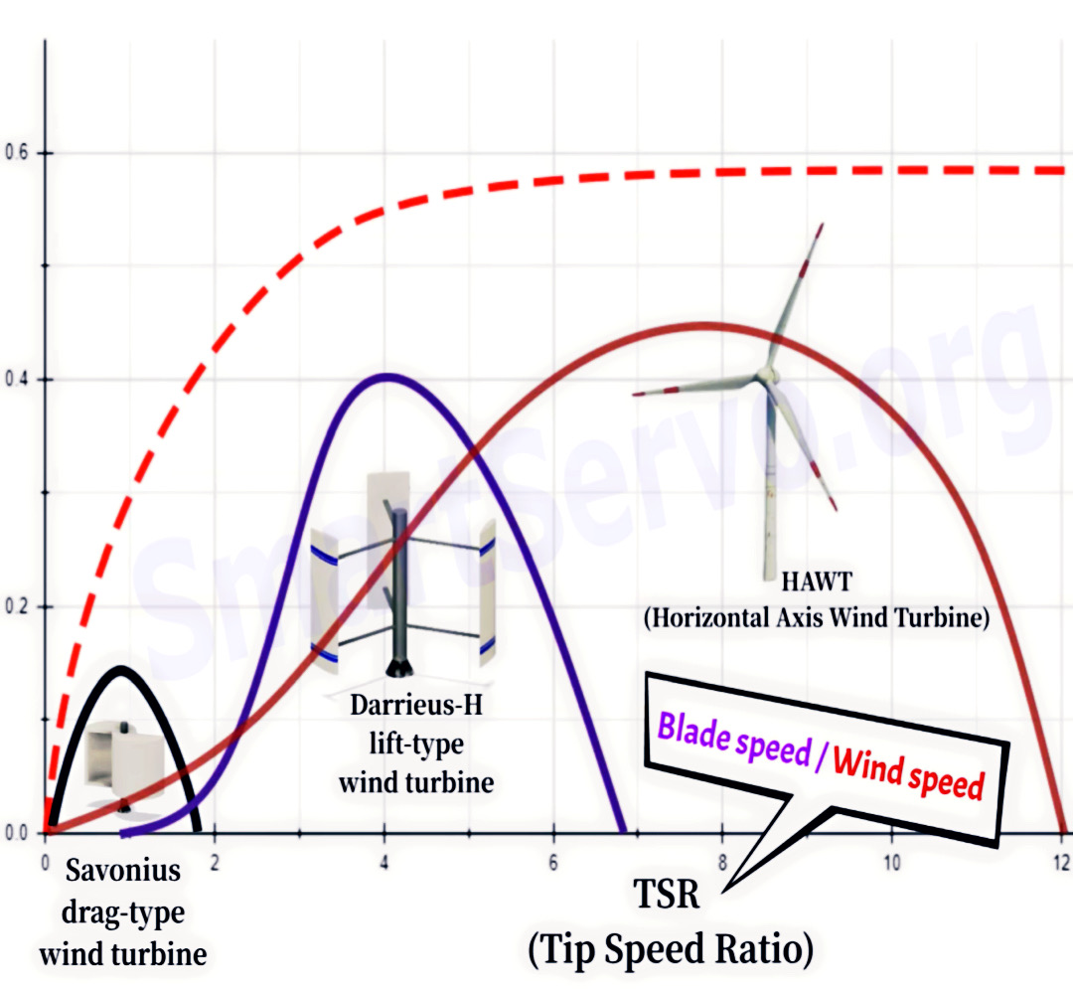
Purpose of choosing Darrieus

Slide 14
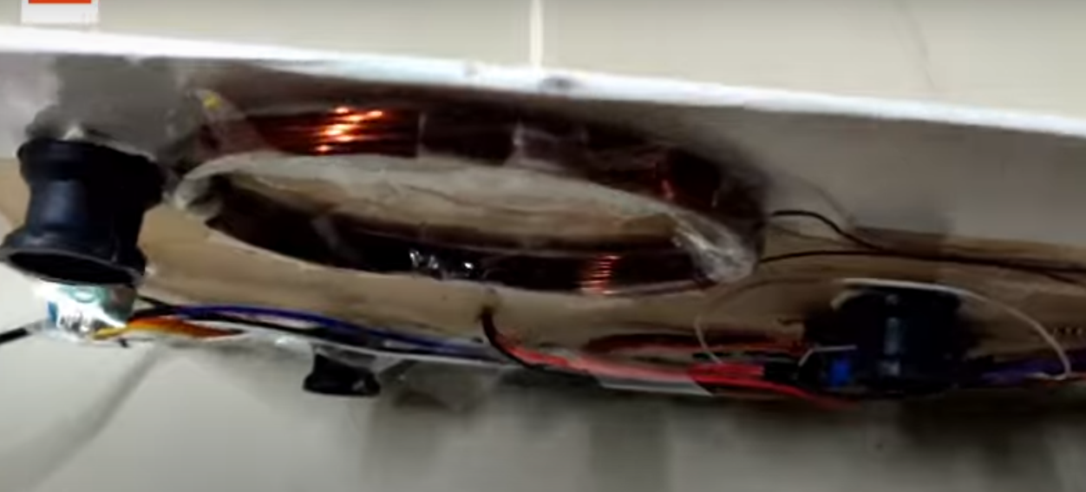
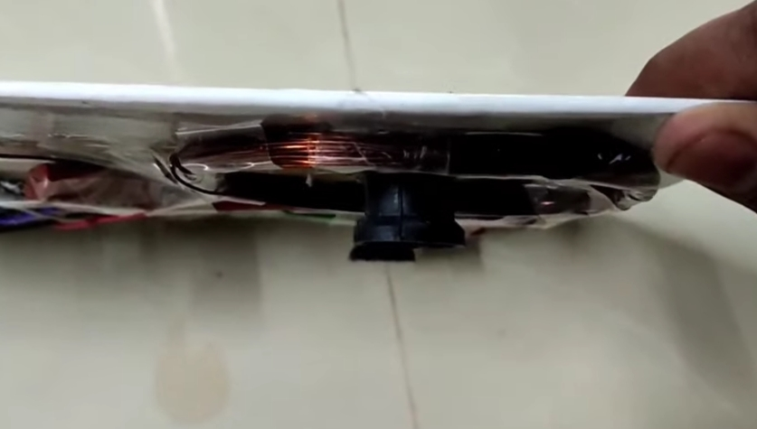
TRANSMITTER
Transmitter is placed under the road in the way of wounding the coil.
It is nearly about 20 m length.
Moment of charging on drive is progressed.

Slide 15
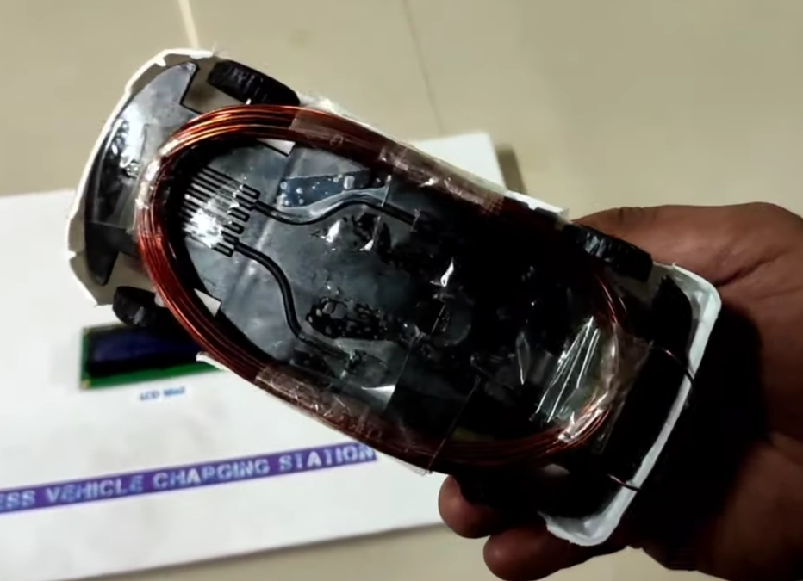
RECEIVER
Receiver is placed in the car to charge while driving.
After fully charged, the car can arrive the next target distance.

Slide 16
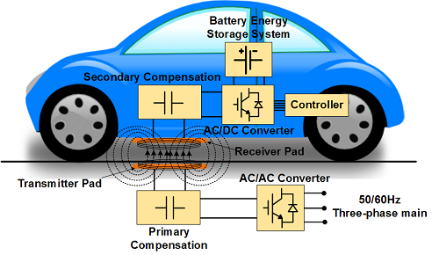
METHODOLOGY
Inductive Power Transfer (IPT) technology
Inductive power transfer (IPT) is an emerging technology for transferring power without any physical contact based on electromagnetic induction.

Slide 17
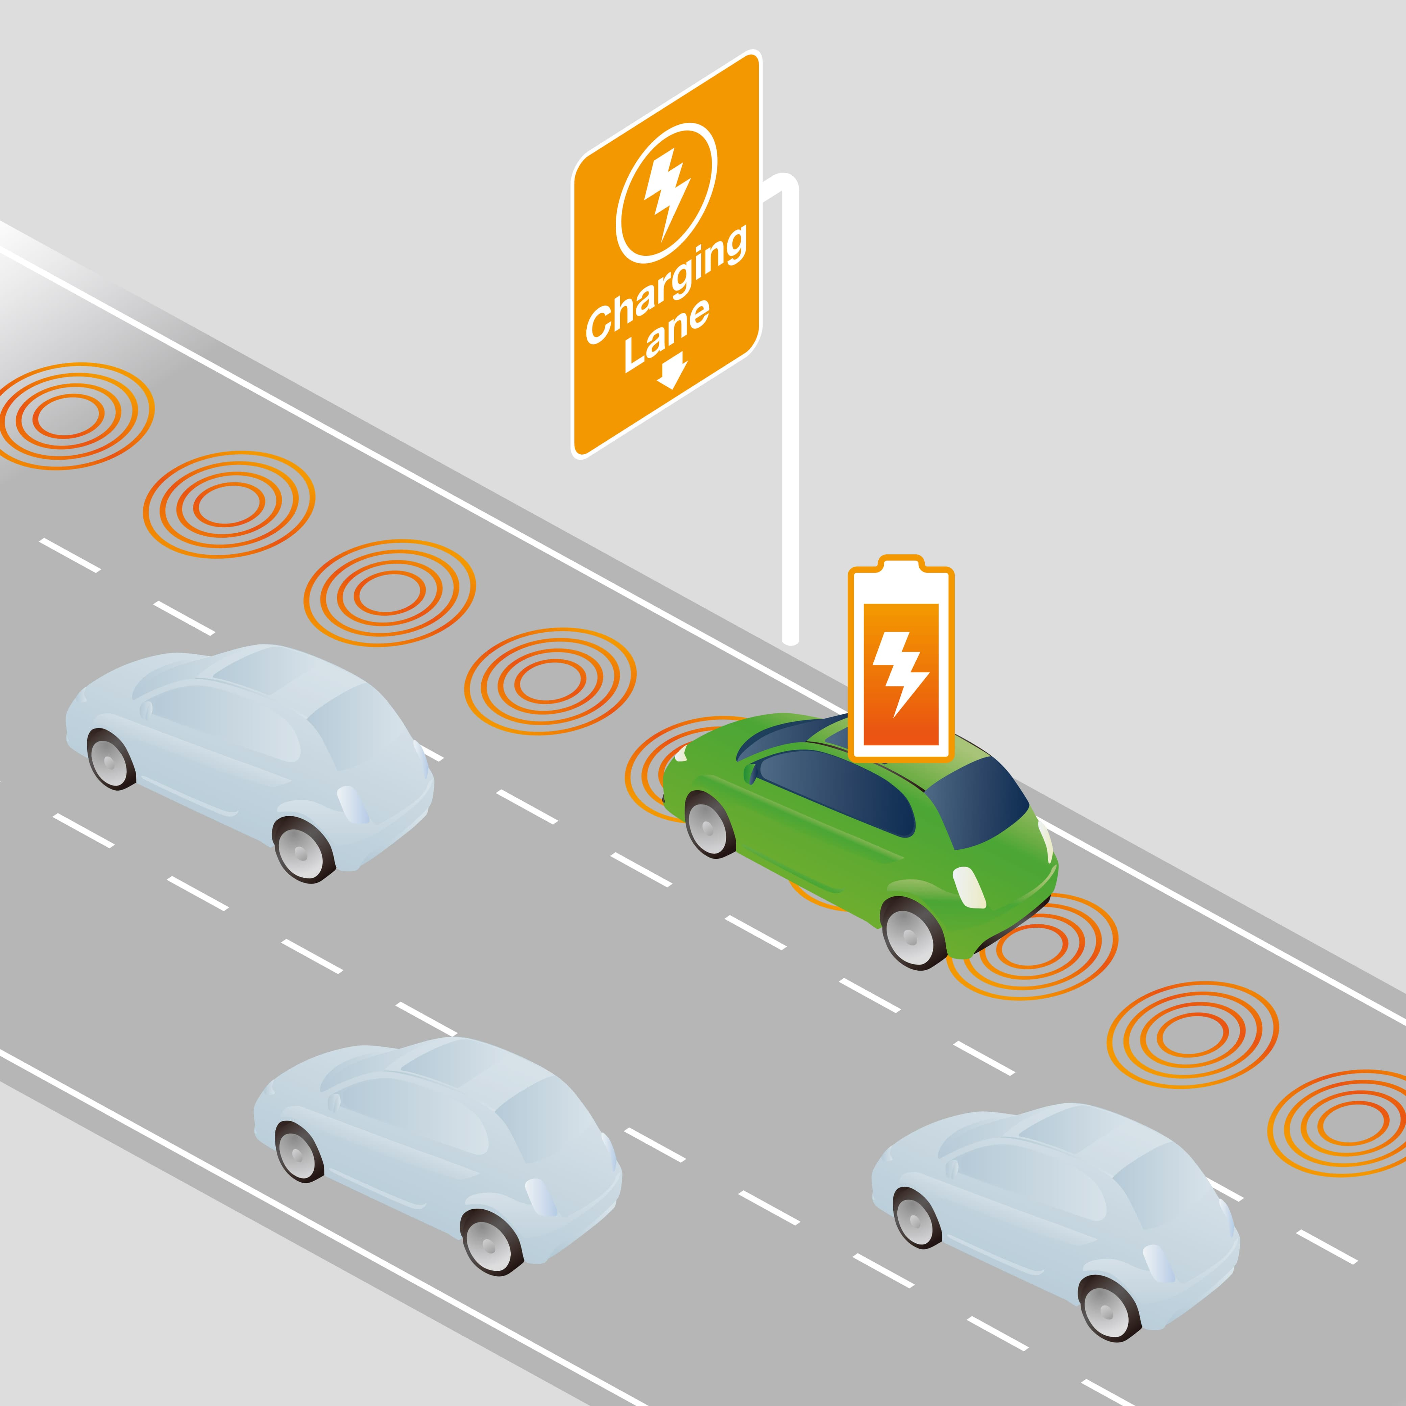
PROJECT OUTCOME

Slide 18
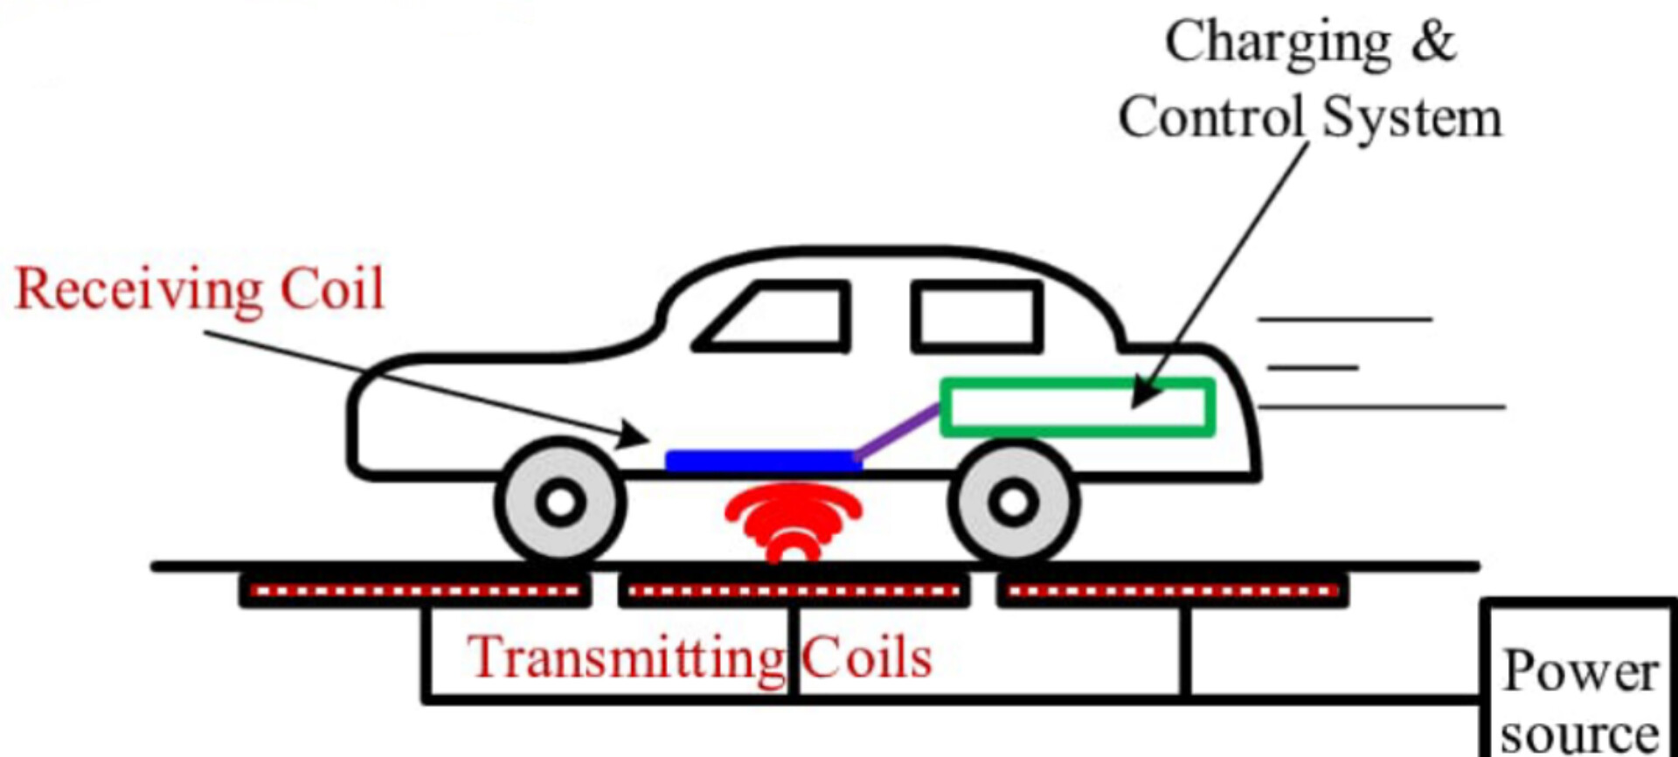
1. Dynamic charging on highways. 2. Autonomous Vehicles 3. Urban transportation networks. 4. Racing vehicles.
APPLICATIONS

Slide 19
REFERENCE
Zicheng BI
- Life Cycle Assessment and Tempo-Spatial Optimization of Deploying Dynamic Wireless Charging Technology for Electric Cars
Qifangchen
Optimal Power Utilizing Strategy for PV-based EV Charging Stations Considering Real-Time Price
Jimeng He
Optimal Site Selection Planning of EV Charging Pile Based on Genetic Algorithm
Si-Yeon Kim
A Study on the Construction of EV Charging Infrastructures in Highway Rest Area

